Slide 1
MCN 7213 - Advanced Software Engineering Processes
Odongo Steven Eyobu, Ph.D
odongo.eyobu@mak.ac.ug

Slide 2
Content
Focus will be on software engineering for smart, critical, and complex software-intensive systems. Four modules will be covered.
1) Requirements specification module focuses on methods to transit from user requirements to high-quality technical requirements;
2) Testing management model focuses on testing strategies;
3) Code quality module focuses on code analysis, code review, and code refactoring;
4) Complex system module focuses on verification and validation of complex software systems.

Slide 3

Organization
Assessments
Course work (Assignments, tests/project, class discussions, participation and attendance) - 40%
Final exam/ Project (60%)

Slide 4
At the end….
After having taken this course, students should be able to:
Identify and correct typical requirements quality issues;
Apply different testing, code review, code analysis, and code refactoring approaches;
Explain industrial state of the practice methods of verifying and validating high-assurance software-intensive system;

Slide 5
Focus?
I will identify projects which students will take on to practically implement all the indicative content of the course.
Published research papers giving scientific orientations of the subjects will be studied and discussed by students.

Slide 6
Research paper 1
https://www.researchgate.net/publication/221229519_From_Rich_User_Requirements_to_System_Requirements

Slide 7
FROM USER REQUIREMENTS TO TECHNICAL REQUIREMENTS
Quality Function Deployment
House of Quality is a part of a larger process called QFD, which stands for Quality, Function, Deployment.
This represents quality-monitoring, a focus on the function of execution of a quality plan, and the application of resources for deployment of that plan.
While the name, QFD, does not encapsulate all that QFD covers, it is a name that has been around for quite some time.
It is familiar, so organizations continue to use it. The House of Quality name comes from the very useful diagram used to make this plan that resembles a house, which we will dig into shortly

Slide 8
Primary Purposes of QFD & House of Quality
Quality Function Deployment
Understand Customer Desires Many times, customers need outside perspective to discover what they really need to build their product or process. The goal is to understand customers perhaps even better that they understand themselves so as to open their eyes to ideal solutions.
Understand Customer Priorities During the interview stage, get to know customer needs, but then break those needs down into prioritized parts. For example, if a customer is building drones for media production, how important is battery life compared to camera quality? How important is aesthetic compared to quality of the drone body? Weights are assigned to each quality based on what is most important to the customer. How well each need is met is ultimately how the customer will judge your solution’s value.
Departmental Buy-In Often, disagreement or misunderstanding between departments of a customer’s organization can occur in relation to what is actually needed. Marketing may think that a drone with trending features is top priority, but engineering may think that overhaul of a problematic part is top priority. The process helps create a plan that addresses all true priorities and to which all departments can agree.

Slide 9
Primary Purposes of QFD & House of Quality
Translate Customer Desires Into Goals & Technicalities This is the heart of the QFD process where the recorded desires of the customer are ranked by priority and specific process and resource planning takes place. They are laid out onto a useful diagram labeled the House of Quality.
Specify Traceable Requirements Specific requirements for the execution of the customer’s product or process should be laid out. The how and why questions should be answered in the plan–how are we meeting the client’s requirements and why are we doing it this way? The written requirements and should be specific enough that their completion and success are traceable. One should be able to work forward and backward in the plan and determine easily whether or not the overall plan is being executed successfully. For example, if there is a question on why something is done a certain way, one should be able to trace back to the beginning of the process to the initial requirement that determined the process needed to meet that requirement.

Slide 10
Primary Purposes of QFD & House of Quality
Provide Structure It is easy for customers to jump all over the place stating what they desire and tossing out ideas. But, at the end of the day, your role is to hone in on what they want and provide a logical, executable, traceable structure to organize their ideas.
Allocate Resources Whether developing a physical product or creating a process for a customer, resources are needed to do so. Humans, machines, computers, construction materials, disposable materials and more must be accounted for. What do we have available to us and what do the available resources allow us to do? Answering these questions is a critical part of execution.

Slide 11
FROM USER REQUIREMENTS TO TECHNICAL REQUIREMENTS
Quality Function Deployment (QFD)
https://www.whatissixsigma.net/house-of-quality-qfd/
http://stcsn.ieee.net/e-letter/stcsn-e-letter-vol-2-no-3/turning-user-requirements-into-technical-features-with-the-house-of-quality

Slide 12
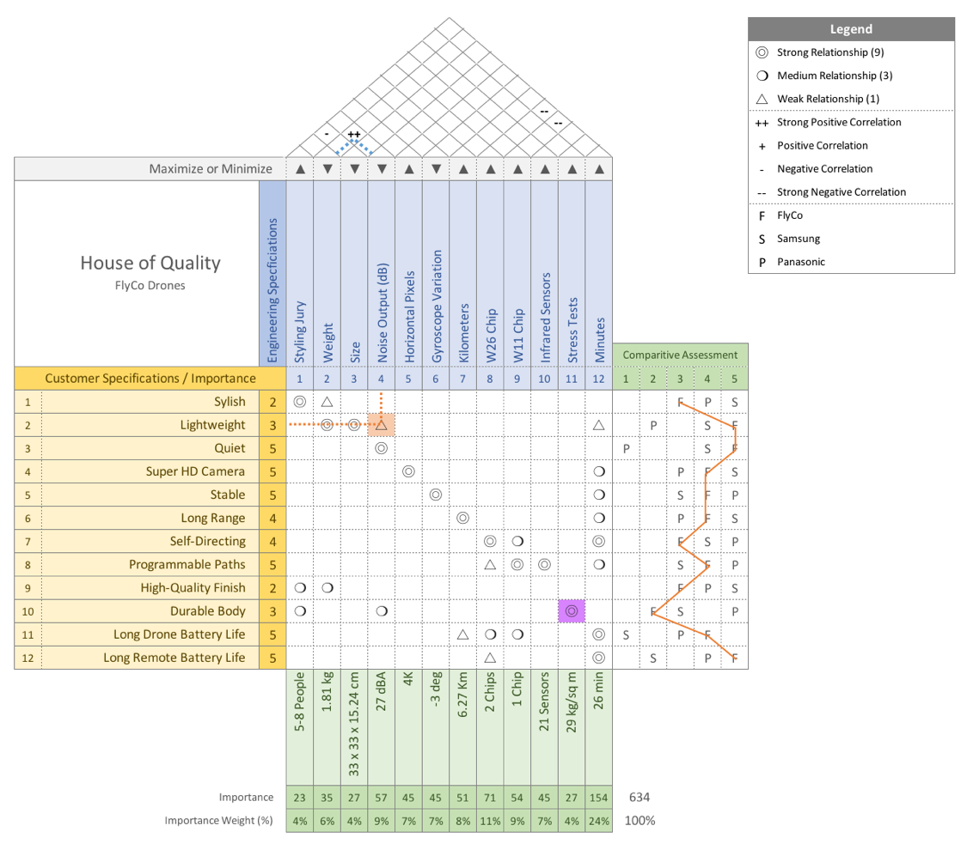
House of Quality (HoQ)
https://www.youtube.com/watch?v=6vfXX_njzvE
https://www.youtube.com/watch?v=u9bvzE5Qhjk

Slide 13
FROM USER REQUIREMENTS TO TECHNICAL REQUIREMENTS
Project 1: QFD
Each student will select a problem case with user requirements and proceed to conduct a QFD process which should be represented using a HoQ diagram.

